Slide 1

Python web scraping Tutorial
Intro – Disclaimer
TigerStyle Code Academy

Slide 2
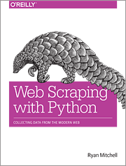
Intro
Web Scraping with Python
http://amzn.to/2sOGBZU (affiliate link)
What is Web Scraping?
Why Web Scraping

Slide 3
Tools and setup
Python3
VS Code

Slide 4
Disclaimer
I’m not responsible
Learning resource
Obtain necessary permissions – your responsibility

Slide 5
Legalities and Ethics of Web Scraping
Laws
Trademarks
Copyrights
Patents
Copyright Law
Trespass to Chattels
The Computer Fraud and Abuse Act
Robots.txt and Terms of Service

